Slide 1
Worms: Identifying Impacts on Education and Health in the Presence of Treatment Externalities
By: Edward Miguel and Michael Kremer: Econometrica, Jan 2004

Slide 2
1
Introduction and Background
2
Strategy and Estimation
3
Treatment Effects and Impacts
4
Conclusion

Slide 3
Introduction
Helminth (Hookworm, Roundworm, Whipworm), and schistosomiasis infections.
Program impact on: 75 rural Kenyan primary schools
Phased- in deworming treatment, in randomized order.
What Did It Do?
  Reduced absenteeism by 25%
  Identify cross-school externalities, by effects on nearby schools using exogenous variation density and randomization

Slide 4
Introduction continued
Evidence of the effects on children of nearby schools
Also evidence of within school treatment externalities randomization was between not within schools, unable to decompose effects from data.
Deworming costs for additional year of school participation is $3.50, which is less than alternative methods of increasing school participation.
No evidence of increased academic test scores ~ school participation gains not large enough to generate statistically significant test score gains.

Slide 5
Introduction continued.
Recent studies (often with randomization at individual level) fail to account for potential externalities for the comparison group (as a result of test group treatments) from reduced disease transmission.
Outcome differences understate the benefits of treatment, as a result of comparison group potential externalities.
Two approaches used to identify effects in presence of externalities:
  randomization at school level: overall effects including others within school
  Cross-school externalities: via effect on nearby schools vs. individual level

Slide 6
Worm Infections affect 3 billion people
While in most cases infections are light, in some cases severe (anemia, protein malnutrition)
Schistosomiasis more severe
Low-cost, single-dose oral therapies kill the worms, reducing infections by 99%. Less successful against whipworm.
But reinfection is rapid with these therapies, and in case of geohelmith and schisto. Therapy must be repeated every 6 mos.
Screening costs are high: Thus WHO recommends mass school-based deworming

Slide 7
School children most affected and most responsible for spread
Children less likely to use latrines, deficate in bush
Geohelminth eggs deposited in local environment: around home or school
Treatment externalities likely to take place over larger area for schistosomiasis as it is spread through infected water; stream and lake currents (used for bathing).
Absent reinfection, worm burdens likely to fall rapidly due to their short life: but still up to 3 years for schistosomiasis; 1-2 years other worm types.

Slide 8
Existing Study by Dickson
Recent studies show that deworming not effective in raising educational outcomes: either on physical growth or cognitive performance ~ Dickson et al. (2000)
However, Dickson study has several shortcomings: randomized deworming within schools to placebo groups and impacts on cognitive performance.
Within school randomization prevents credibly estimating externality benefits.

Slide 9
Dickson Study Continued
Dickson study ignores effects on untreated placebo groups.
These untreated groups experience substantial worm load reductions as a result of within school externalities.
Externalities resulting from the treatment group’s impacts by way of reducing reinfection and transmission rates.
Dickson study makes no provision for these impacts, and greatly understates impact of deworming programs.

Slide 10
School Participation
Miguel and Kremer state that deworming programs have substantial impacts on school attendance.
Recent studies are shown to suffer significant attrition bias in samples since the sick are usually not included in sample
Periods of extended school absence are dropped, causing an overstatement of high rates of attendance.
This overstatement concludes deworming has no affect on school participation ~ Cruz and Pollitt 1996.

Slide 11
Primary School Project, Kenya
Primary School Deworming Project PSDP, Dutch nonprofit (ICS) with Ministry of Health in Busia District
Busia, poor and densely settled farming region in Kenya, with Highest helminth infection rates.
January 1998, the 75 PSDP schools with enrollment of 30,000 pupils (age 6-18) were randomly divided into three groups of 25 schools each.

Slide 12
Project continued
Administrative and financial constraints resulted in phasing in treatment over several years.
1998 - 1999, Group 1 schools received free deworming treatment.
1999, Group 2 treated
2001, Group 3 treated
Thus, 1998, Group 1 treatment school, Group 2 and Group 3 comparison schools.

Slide 13

Group 1
Group 3
1998
Treatment
Group 1
Begins
1998
Comparison
Group 2
1999
Treatment
Group 2
Begins
Group 2

Slide 14
Busia project continued
1999, Group 1 and Group 2 treatment schools, Group 3 comparison schools.
Despite randomization: Baseline data showed Group 1 worse off than other groups in some dimensions: blood in stool, cleanliness, exam scores potentially creating bias against finding significant program effects.
But these differences not significant at traditional confidence intervals.

Slide 15
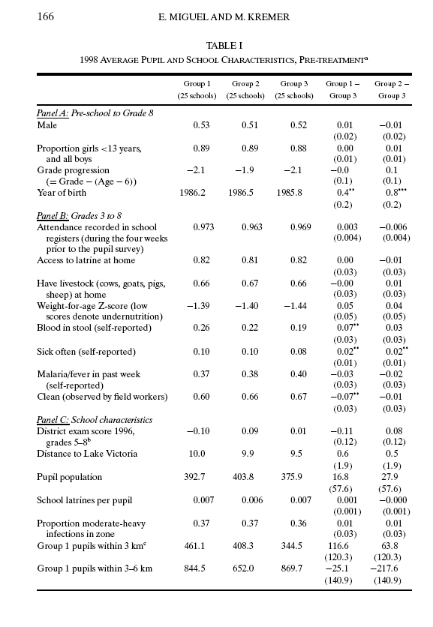

Slide 16
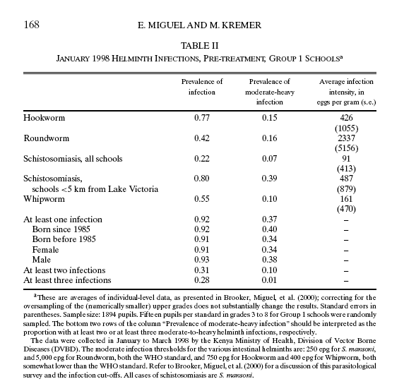

Slide 17
Prior to treatment Parasitological Survey Conducted on randomly selected students (15 per grade)
Note data showing 92% had at least one worm infection
Probably higher due to the sick being absent from school

Slide 18
WHO Treatment Selection Rules
Mass treatment with drugs every 6 months when prevalence rates reached a certain threshold
All 25 schools in group 1 qualified for geohelmith treatment, 6 for schist.
Did not treat girls of reproductive age 13+ because of concerns for side effects
78% of the eligible students received at least one treatment (major reason for it not being higher was school absences)
Slightly lower % in subsequent years due to stricter consent rules
Only 5% of comparison school pupils received treatment independent of program. Some may have used herbal medicines. Little evidence of transfers of schools to receive treatment

Slide 19
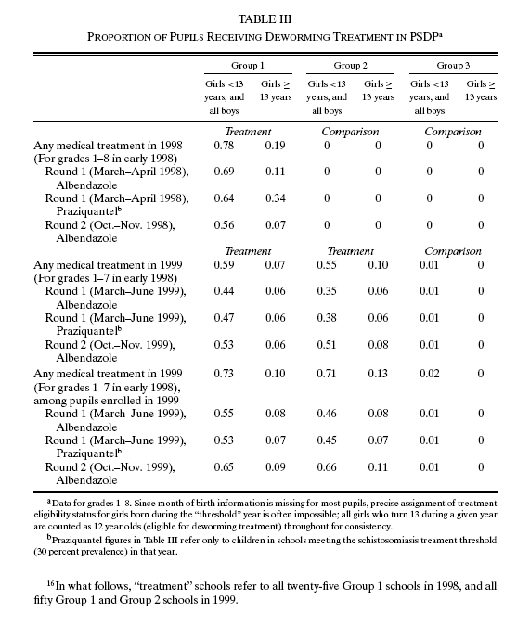

Slide 20
Differences between Groups 1, 2 of grade 3 -8 students
Differences are statistically significant as shown in Table V, though program was less effective against whipworm. The differences would have been larger if taken sooner before reinfection became possible.
Educational programs to change behavior were minimal. Hence program effects came almost entirely from the drug treatments.

Slide 21
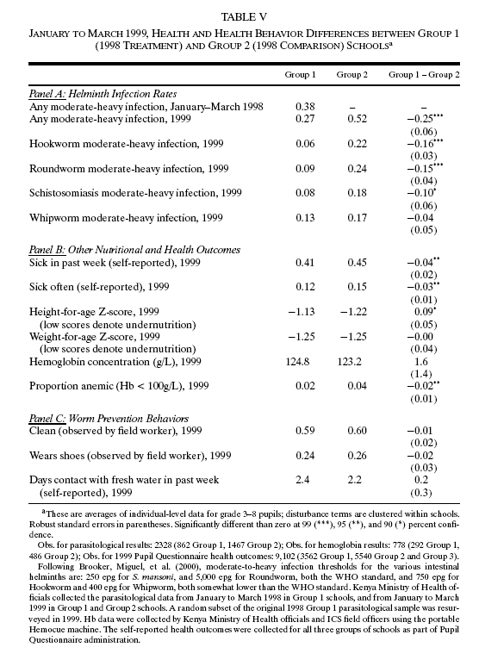

Slide 22

Estimation Strategy
Cross-school externalities, variation in local density of treatment schools induced by randomization
We first estimate program impacts in treatment schools, as well as cross-school treatment externalities.

Slide 23
Y_{ijt}, individual health or education outcome, i = school, j =student, and t = {1, 2} year of program; T_{1it} and T_{2it} are indicator variables for school assignment to first and second year deworming treatment
  X_{ijt,} school and pupil characteristics (controls for pre-treatment differences)
N_{dit}, total number of pupils in primary schools at distance d from school i in year t
N^{T} _{dit}, randomly assigned pupils
U_{i} is school effect and ε_{ijt} unobservable

Slide 24
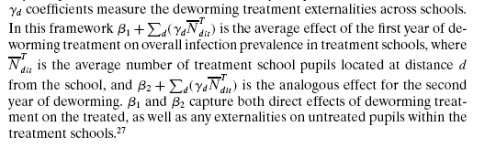

Slide 25
Estimating Within-School Externalities
Randomization at level of schools, rather than individuals within schools
Possible to estimate the overall treatment effect on treated schools and execute a cost-benefit analysis (using Equation 1).
No way to decompose effects into a direct effect on treated pupils and an externality effect on untreated pupils within treated schools since treatment affects health via externalities even in absence of direct treatment.

Slide 26
Within-School continued
Not valid to use assignment to a treatment school as an Instrumental Variable IV; the exclusion restriction on untreated fails to hold due to externalities effects.
Pupils missing treatments are more likely to have moderate to heavy infection levels. Hence no reason to think that sicker pupils would more likely receive treatment than less sick ones in 1998 . Evidence for this in Table VI
Assume children would obtain treatment if net gain > cost
D_{itj} =1(S(X_{ijt},e_{ijt} )+e_{ijt} > C_{t}
Where D_{itj} =1 if individual j in school I received treatment in first year and that her school was eligible
1 is indicator function, C_{t} varied from year to year due to changing consent requirements

Slide 27
Health comparisons Jan-Feb 1999 after group 1 had received treatment but group 2 had not
Holding X_{ijt,} constant between groups for simplicity,

Slide 28
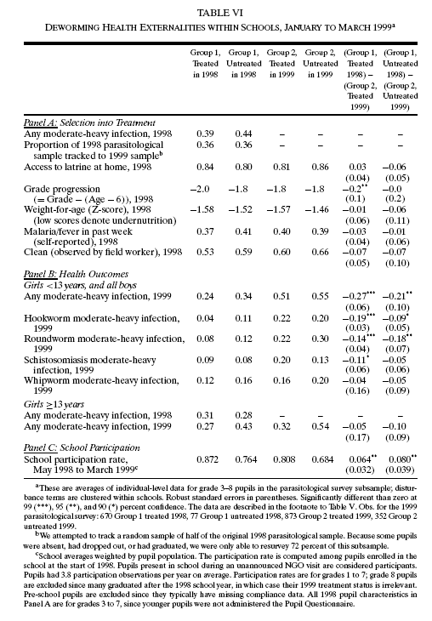

Slide 29
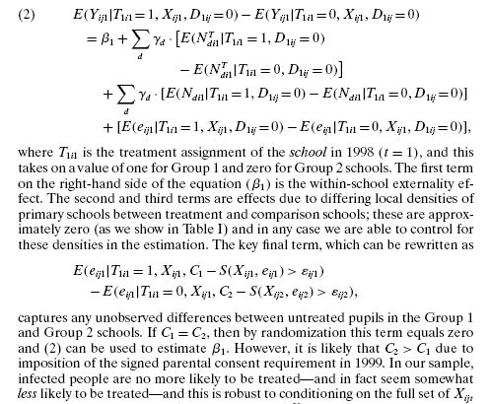
Estimation between Group 1 and Group 2 (holding Xijt constant

Slide 30
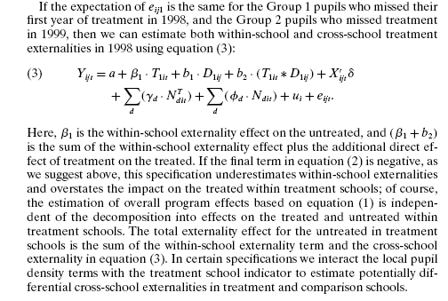
Total Externality Effect

Slide 31
Deworming Treatment Effects on Health and Nutrition
Formal estimation confirms deworming treatment schools experienced a range of health benefits, and provides evidence that these benefits spilled over both to non-treated pupils in the treatment schools and to pupils in the neighboring schools.
Geohelminth externalities were primarily within schools, while schistosomiasis externalities were primarily across schools ~ consistent with modes of disease transmission

Slide 32
Within-School Treatment Effects Continued
Estimation of Equation 1 indicates in early 1999 pupils with moderate to heavy infection were 25% lower in Group 1 compared to Group 2. ~remember Group 1 was treated in 1998, and Group 2 was comparison. Difference statistically significant at 99% level Regression (1) in Table VII
Estimation of Equation 3: decomposes the effect of the program on treated schools into a direct effect on treated pupils (14%) and a within-school externality effect. { 12%) reduction in moderate to heavy infections. (regression (2) in Table VII
From regression (1) results, they calculate incidence of moderate to heavy helminth infections was 23% lower due to spillovers across schools

Slide 33
Own treatment and local treatment effects are not necessarily additive
Cross –school externalities may not reduce infection level below moderate-to-heavy threshold as of the date of para. Survey but the interaction might
From regression (3) Table VII the cross school externality effect for group 2 is 9% points while effect for treatment group is almost 29%
Overall the cross school externalities account for this 9% + the previous 25% = 35%. This is more than ¼ of total

Slide 34
Calculation or reduction in moderate-to-heavy infections
5190 such infections eliminated which is about 1 infection per treated child in group 1 schools
If externalities go beyond 6 kms., this will be an underestimate
They are likely to go over greater distances for schist.
Regressions (3), (6) and (9) calculate the interaction terms strong for helminth and geohelminth but weak for schisto.
Pupils in comparison and treatment groups benefit similarly from proximity to treatment in shisto but those in treatment schools gain more than comparison pupils in geohelminth

Slide 35
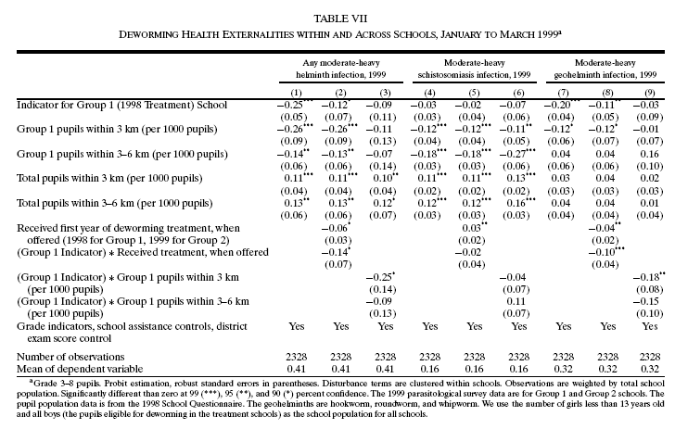

Slide 36
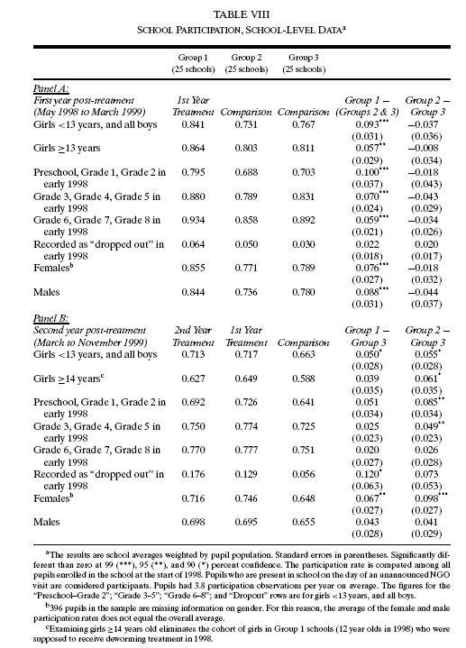

Slide 37
Deworming Treatment Effects on School Participation
7% Increase in participation within treatment schools, with 25% reduction in total school absenteeism.
After accounting for externalities, impact of school participation increased 0.14 years of schooling per pupil treated through the program.

Slide 38
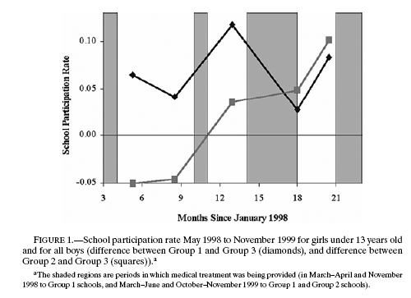
School Participation Rate

Slide 39
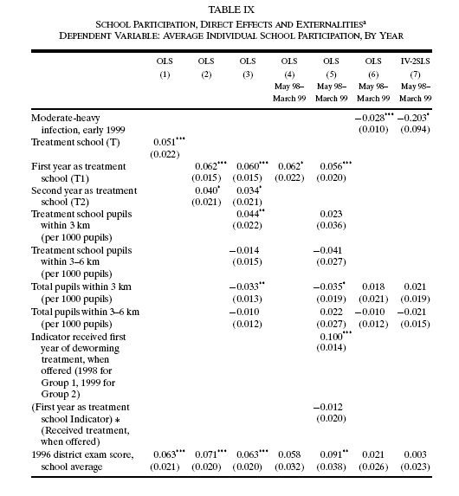

Slide 40
Table IX
Regressions 1 and 2 present “naïve” treatment effects that ignore the possibility of externalities.
Estimation of Equation 1 in regression 3 shows 4.4% increase in average school participation ~ for each additional thousand pupils attending treatment schools within three kilometers.

Slide 41
Deworming Treatment Effects on Test Scores
Deworming could improve test scores by increasing school participation rates, and general health and mental clarity.
Demonstrates in Table VIII that deworming increases participation rate by 7+% points
However, given the observed cross-sectional relationship between participation and test scores, the absence of a strong school attendance effect on test scores may not be surprising.

Slide 42
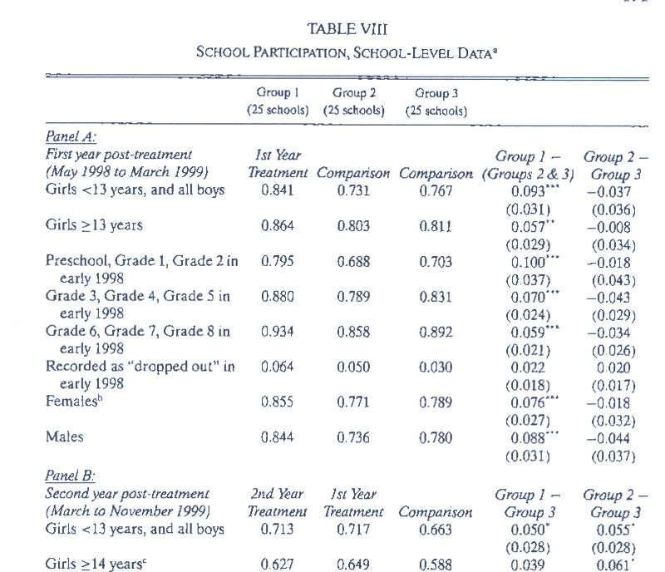

Slide 43
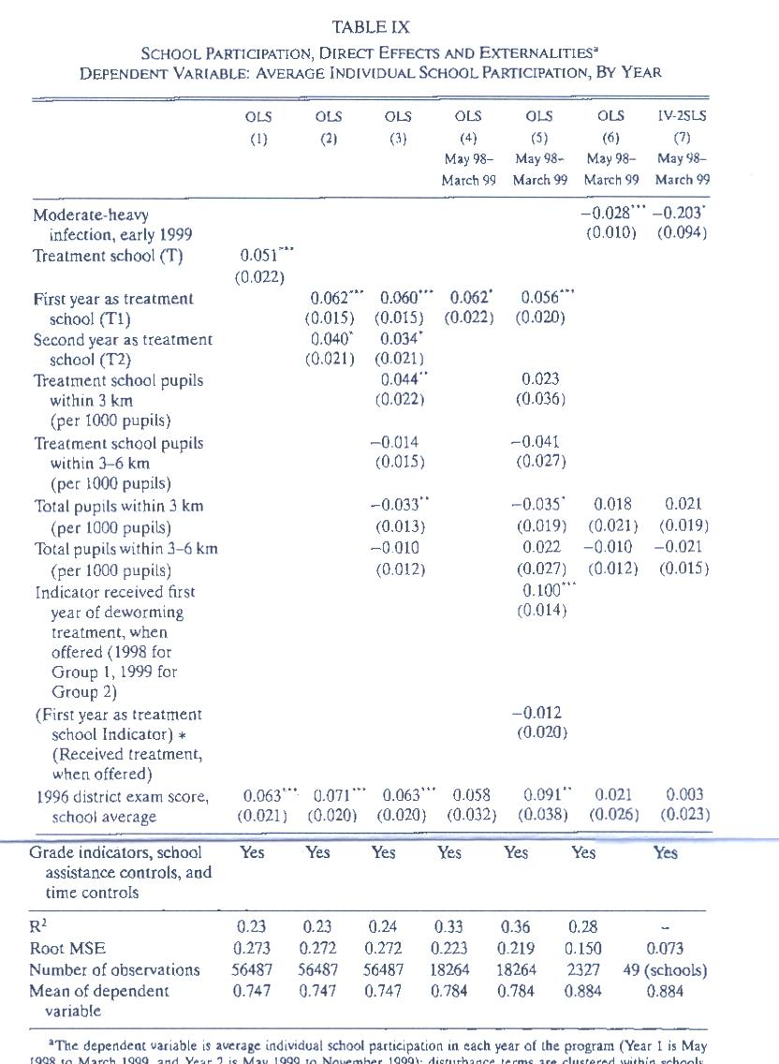

Slide 44
Externalities still important
As in regression (3) even though measurement of participation starts right after treatment and continue, so that at first the effect would be almost entirely direct.
Average participation is 2% points higher throughout area due to deworming externalities
Regression (5) shows the within school externality effect to be 5.6% points. No significant difference in participation between the treated and untreated pupils in these schools
Regression (7) shows that IV estimates (wherein all increases must come by way of changes in infection status yield larger effects but this may be due to attenuation bias in measurement of severity.

Slide 45
Cost Effectiveness and Welfare Analysis
Should mass school-based deworming treatment be a public policy?
Health Cost Effectiveness Approach
Educational Cost Effectiveness
Deworming as Human Capital Investment
Externalities and Optimal Deworming Subsidies

Slide 46
Health Cost Effectiveness Approach
Deworming costs estimates of .49 US$ per pupil, per year in a large-scale intervention in Tanzania.
By including externalities effects, costs for treatment and benefits (using results similar to regression 3 in Table VII) ~ this would provide up to 75% reduction in the Disability Adjusted Life Year costs DALY.

Slide 47
Educational Cost Effectiveness
Deworming was the most cost-effective method for improving school participation, among a series of interventions implemented by ICS in this region of Kenya.
Given that the deworming program increased school participation by 0.14 years per treated child, a large scale program with the Tanzania PCD cost of .49 $US / .14, or $3.50 US dollars per additional year of school participation.

Slide 48
Deworming as Human Capital Investment
Given that the PSDP increased school participation but not test scores, any calculation about its effects on human capital accumulation are speculative.
However, a rough estimate suggest that labor market benefits from deworming far outweigh their costs.

Slide 49
Externalities and Optimal Deworming Subsidies
While PSDP deworming treatment concludes substantial externalities, it is difficult to draw firm conclusions about optimal deworming subsidies.
Possibly a marginal positive externalities model could provide a way to conduct a lower, yet effective, coverage-treatment area to establish a reduction for subsidies.
Additional research still needed to determine an appropriate method for establishing optimal deworming subsidies.

Slide 50
Randomization at school-group level treatment
Captures
Externalities
Of Treatment
Increased
School
Participation
Evidence
Identification
Of Overall
Program
Impact on Group
Greater
Variation
In Local
Treatment
Densities

Slide 51
Conclusion
Deworming program in Kenya led to a 7.5% average gain in primary school participation in treatment schools, reducing overall absenteeism by 25%.
Externalities alone justify fully subsidizing deworming treatment, and even for paying people to receive treatment.
Externalities captured in methodological approach, and for randomized evaluations more generally.

Slide 52
Thank You!

